Slide 2
Factor G.C.F. | D2PS | Factor a Trinomial | Factor Completely | Mixed Factoring
$100 | $100 | $100 | $100 | $100
$200 | $200 | $200 | $200 | $200
$300 | $300 | $300 | $300 | $300
$400 | $400 | $400 | $400 | $400
$500 | $500 | $500 | $500 | $500

Slide 3

Factor using G.C.F. : $100
$$x^{2}+x$$

Slide 4
$$x^{2}+x$$
Correct answer: x(x+1)

Slide 5
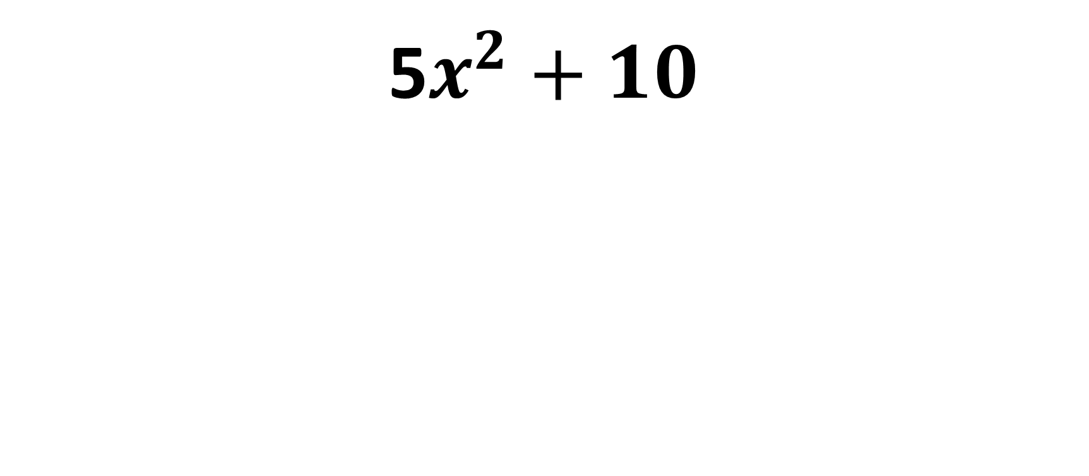
Factor using G.C.F. : $200
5$x^{2}+10$

Slide 6
5$x^{2}+10$
Correct Answer: 5($x^{2}+2)$

Slide 7
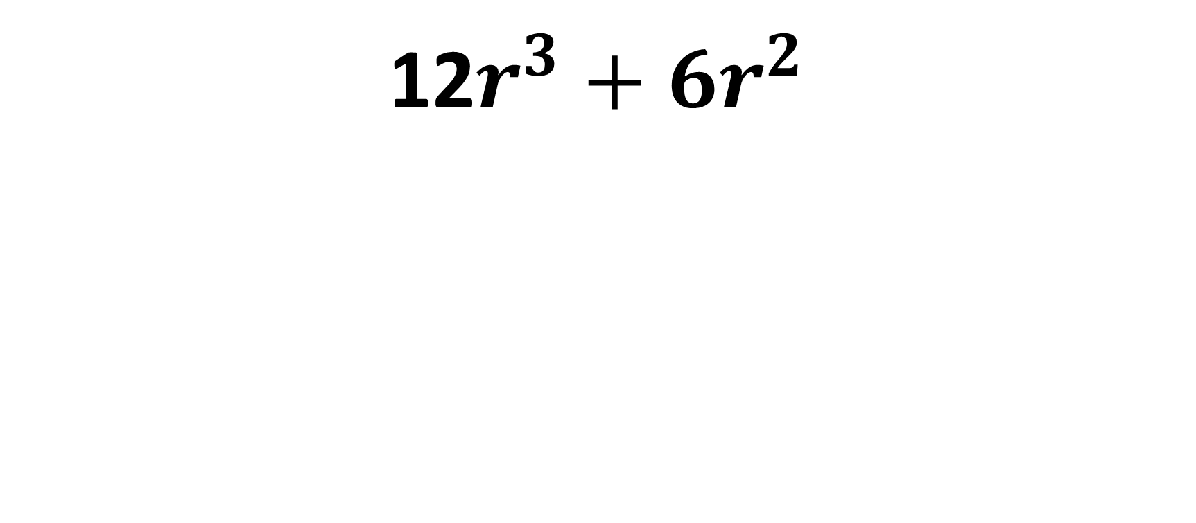
Factor using G.C.F. : $300
12$r^{3}+{6r}^{2}$

Slide 8
12$r^{3}+{6r}^{2}$
Correct answer: $6r^{2}(2r+1)$

Slide 9
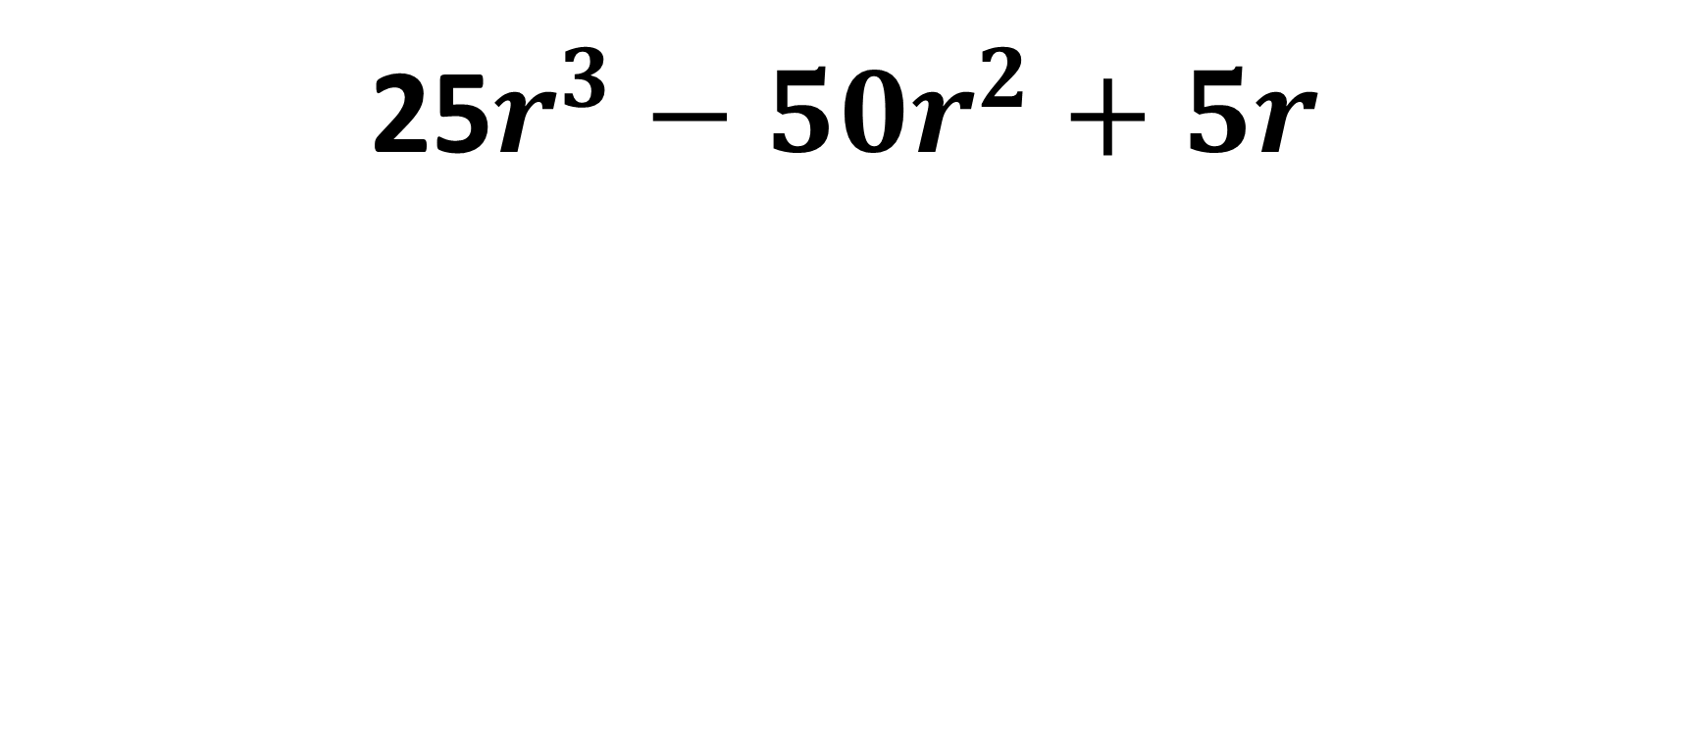
Factor using G.C.F. : $400
25$r^{3}−{50r}^{2}+5r$

Slide 10
25$r^{3}−{50r}^{2}+5r$
Correct answer: $5r(5r^{2}−10r+1)$

Slide 11
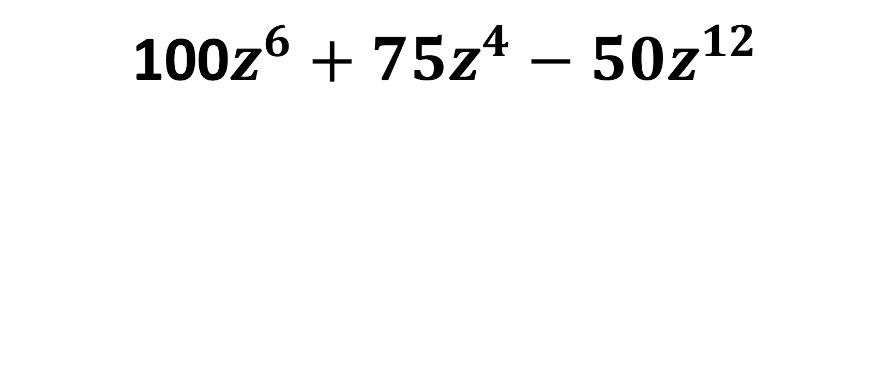
Factor using G.C.F. : $500
100$z^{6}+{75z}^{4}−50z^{12}$

Slide 12
100$z^{6}+{75z}^{4}−50z^{12}$
Correct answer: ${25z}^{4}({4z}^{2}$+$3−{2z}^{8})$

Slide 13
Factor using D2PS: $100
$$x^{2}+4$$

Slide 14
$$x^{2}+4$$
Correct answer: $(x+2)(x−2)$

Slide 15

Factor using D2PS: $200
$$a^{2}−36$$

Slide 16
$$a^{2}−36$$
Correct answer: $(a+6)(a−6)$

Slide 17

Factor using D2PS: $300
$$Z^{2}−81$$

Slide 18
$$Z^{2}−81$$
Correct answer: $(Z+9)(Z−9)$

Slide 19

Factor using D2PS: $400
$${4x}^{2}−25$$

Slide 20
$${4x}^{2}−25$$
Correct answer: $(2x+5)(2x−5)$

Slide 21

Factor using D2PS: $500
$${64x}^{2}−49$$

Slide 22
$${64x}^{2}−49$$
Correct answer: $(8x+7)(8x−7)$

Slide 23

Factor the Trinomial: $100
$$x^{2}+5x+6$$

Slide 24
$$x^{2}+5x+6$$
Correct answer: $\left(x+3\right)\left(x+2\right)$

Slide 25

Factor the Trinomial: $200
$$x^{2}+2x−15$$

Slide 26
$$x^{2}+2x−15$$
Correct answer: $(x+5)(x−3)$

Slide 27

Factor the Trinomial: $300
$$x^{2}+10x+24$$

Slide 28
$$x^{2}+10x+24$$
Correct answer: $(x+6)(x+4)$

Slide 29

Factor the Trinomial: $400
$$x^{2}−7x+6$$

Slide 30
$$x^{2}−7x+6$$
Correct answer: $\left(x−6\right)\left(x−1\right)$

Slide 31

Factor the Trinomial: $500
$$x^{2}−3x−18$$

Slide 32
$$x^{2}−3x−18$$
Correct answer: $(x−6)(x+3)$

Slide 33
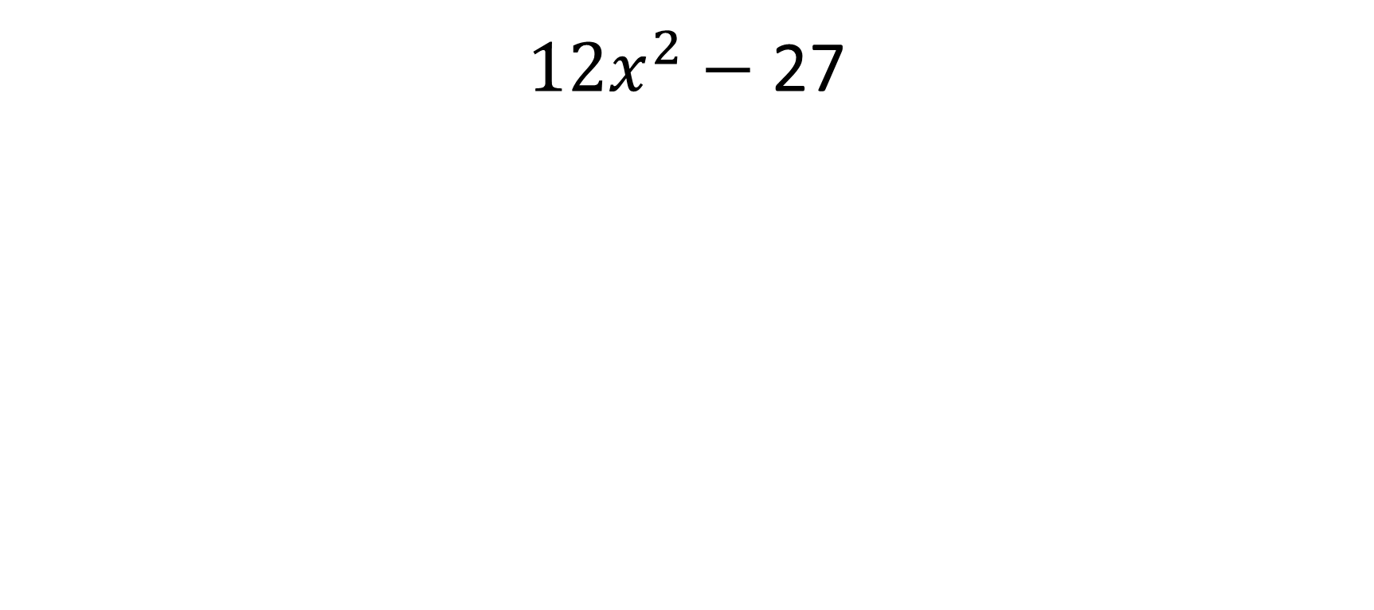
Factor completely: $100
${12x}^{2}−$27

Slide 34
${12x}^{2}−$27
Correct answer:
${3(4x}^{2}−$ 9)
3(2x + 3)(2x – 3)

Slide 35

Factor completely: $200
$${72x}^{2}−{50y}^{2}$$

Slide 36
$${72x}^{2}−{50y}^{2}$$
Correct answer:
$2({36x}^{2}−{25y}^{2}$)
2(6x + 5y)(6x – 5y)

Slide 37

Factor completely: $300
$${3x}^{3}+27x^{2}+60x$$

Slide 38
$${3x}^{3}+27x^{2}+60x$$
Correct answer:
$$3x(x^{2}+9x+20)$$
3x(x + 4)(x + 5)

Slide 39

Factor completely: $400
$${3x}^{4}+{9x}^{3}−{12x}^{2}$$

Slide 40
$${3x}^{4}+{9x}^{3}−{12x}^{2}$$
Correct answer:
${3x}^{2}\left(x^{2}+3x −4\right)$
$$\left(x+4\right)\left(x−1\right)$$

Slide 41
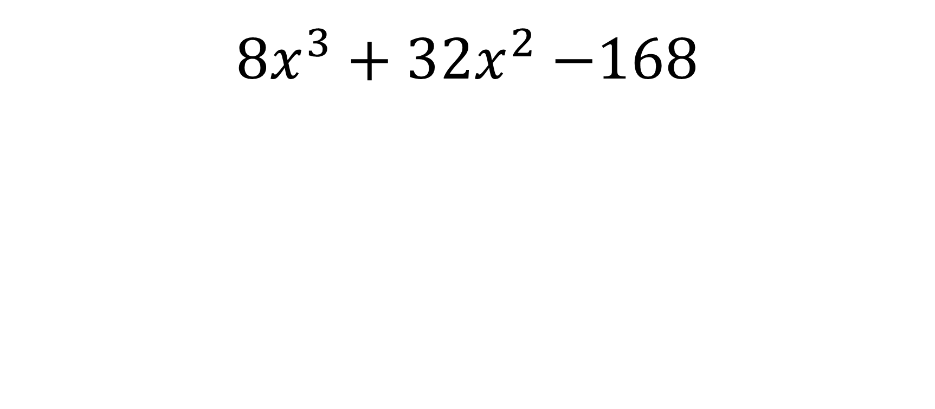
Factor completely: $500
${8x}^{3}+32x^{2}−$168

Slide 42
$${8x}^{3}+32x^{2}−\text{168}$$
Correct answer: $8x\left(x^{2}+4x − 21\right)$
8x(x + 7)(x – 3)

Slide 43

Mixed Factoring: $100
G.C.F.
$${7x}^{5}+21x^{3}$$

Slide 44
$${7x}^{5}+21x^{3}$$
Correct answer: $7x^{3}\left(x^{2}+3\right)$

Slide 45

Mixed Factoring: $200
D.2.P.S.
$$x^{2}−49$$

Slide 46
$$x^{2}−49$$
Correct answer:$(x+7)(x−7)$

Slide 47

Mixed Factoring: $300
D.2.P.S.
$$9x^{2}−64$$

Slide 48
$$9x^{2}−64$$
Correct answer: $(3x+8)(3x−8)$

Slide 49

Mixed Factoring: $400
Factoring trinomials:
$$x^{2}−27+50$$

Slide 50
$$x^{2}−27+50$$
Correct answer: $(x−25)(x−2)$

Slide 51

Mixed Factoring: $500
Factor completely:
$$x^{3}−x$$

Slide 52
$$x^{3}−x$$
Correct answer: $x(x+1)(x−1)$

